Slide 1


Online Shopping System
FINAL DEFENSE
TITLE OF PROJECT REPORT (I)
A web-based application
Prepared By: Rijan Manandhar
TU Reg. No: 6-2-530-53-2022

Slide 2
TABLE OF CONTENTS
Introduction
Problem statement
Objectives
Scope and Limitation
Literature and background review
System analysis
System Design
Interface Design
Implementation
Tools Used
Implementation Details of Modules
Testing
Conclusion

Slide 3
LIST OF FIGURES
Use-case Diagram
Gantt Chart
ER-Diagram
DFD
Architectural Design
Database Schema Diagram
UI Design
Wireframe
Waterfall Model

Slide 4
LIST OF TABLES
Software Requirements
Hardware Requirements
Test Case 1
Test Case 2
Test Case 3
System Testing

Slide 5
INTRODUCTION
Online Shopping System is a web-based platform designed to facilitate products view and add to cart for buying products among users.
Users access the system through a secure login page, with users required to register beforehand.
This documentation will cover the key features, design architecture, implementation, and testing phases of the Online Shopping System a web application, offering a comprehensive overview of its development and operational capabilities.

Slide 6
PROBLEM STATEMENT
Digital Transformation
Internet Connectivity
Consumer Trust Issues
Payment Preferences
COD Challenges
Logistical Barriers

Slide 7
OBJECTIVES
To generate reports of products
To allow user to view products and add to cart
To facilitate user for shopping right products easily

Slide 8
Scope & Limitation
shopping cart management, order placement, and payment integration.
Offers full control over the development environment for customization of interfaces, catalogs, and payment systems.
Provides experience in database management, authentication, security, and basic e-commerce workflows.

Slide 9
LIMITATIONS
The localhost environment cannot handle a large number of concurrent users and transactions due to resource limitations.
While the website will operate on smaller displays, compared to a mobile app, its usability may suffer from a less dynamic or simple layout.
Lacks secure payment gateways, real-time inventory management, and third-party delivery/logistics integration.

Slide 10
Literature & Background Review
Literature Review
1.Okdam.com
2.Muncha
3. Socheko

Slide 11
Continue..
Background Review
Lack of consumer trust in e-commerce.
Unreliable internet, especially in rural areas.
Easy login, product browsing, and selection.
Tools for cart and payment.

Slide 12
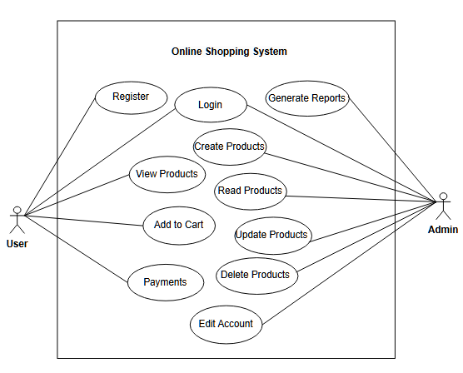
SYSTEM ANALYSIS
1. Functional Requirement
Figure 1: Use case Diagram

Slide 13
Non-Functional Requirement
The user interface must be easy to navigate.
The system must be simple to use and view products.
The system must provide responsive design so the application works.

Slide 14
Table 1: Software Requirements for Online Shopping System
SN | Software | Purpose
1 | Visual Studio Code | Code Editor
2 | DBMS | Store data and information
3 | Microsoft Word | Documentation
4 | Snipping Tool | Screenshots
5 | Draw.io | Drawing images

Slide 15
Table 2: Hardware Requirements for Online Shopping System
SN | Hardware Requirements | Specification
1 | Processor | Intel core i3 2.0 GHz or higher
2 | RAM | 2 GB or higher

Slide 16
Feasibility Analysis
1. Technical Feasibility
Technologies like HTML, CSS, and JavaScript will be used for the front-end. For the back-end, PHP can be chosen to manage user data, cart data, and reports.
2. Operational Feasibility
The system is web-based, so it is platform independent which needs to be accessed through using different platforms.
3. Economic Feasibility
A simple cost-benefit analysis comparing development and operational costs with expected revenue would indicate whether the project is economically feasible.

Slide 17
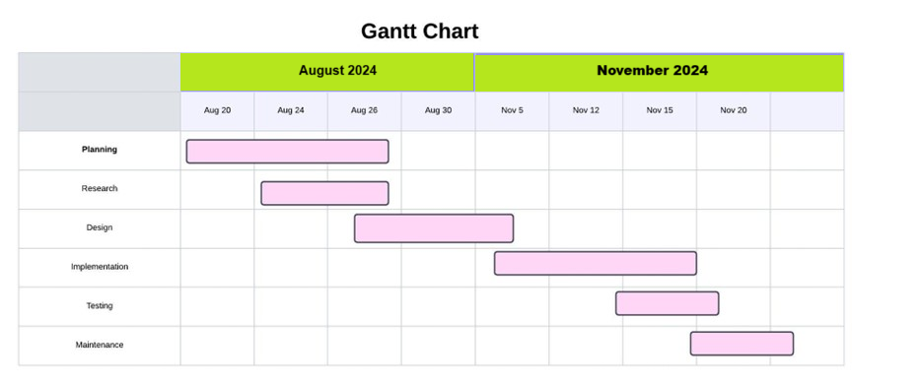
Schedule Feasibility
Figure: Gantt chart of Online Shopping System

Slide 18
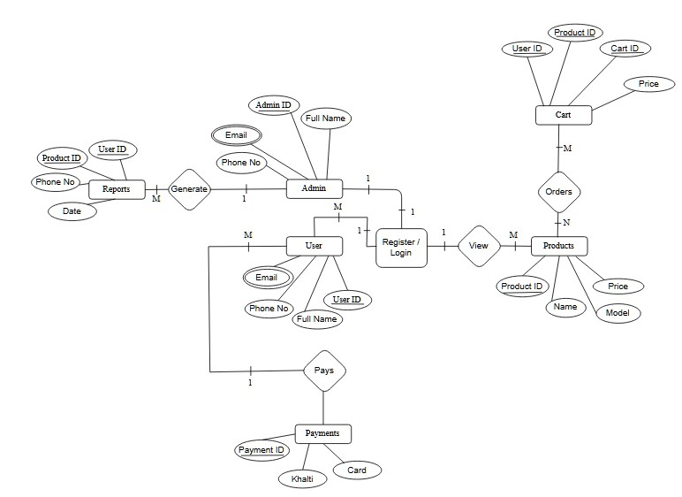
Data Modelling (ER-Diagram)
Figure: ER-Diagram

Slide 19
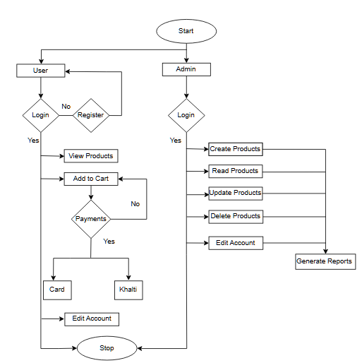
FLOW CHART

Slide 20
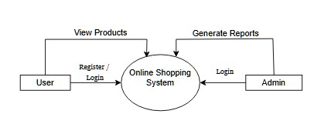
Process Modelling (DFD)
Figure: Process Modelling Level 0 DFD

Slide 21
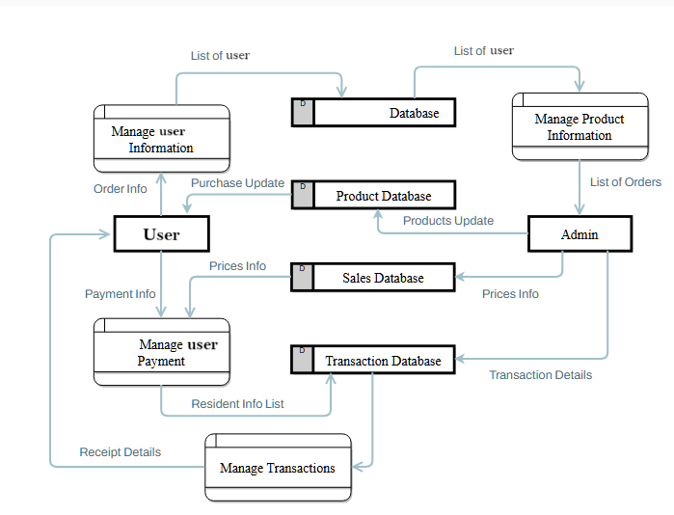
DFD (Level-1)
Figure: Level 1 Data flow Diagram of Online Shopping System.

Slide 22
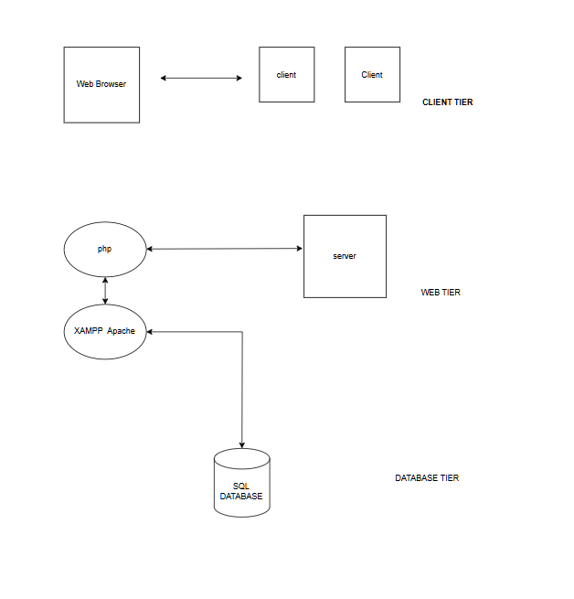
System Design
Architectural Design
Figure: Architecture Design

Slide 23
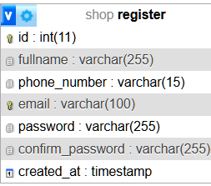
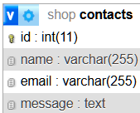
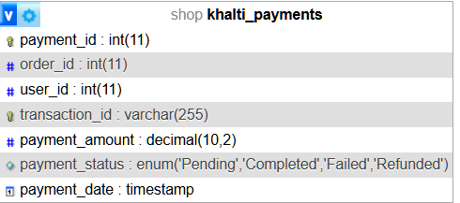
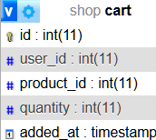
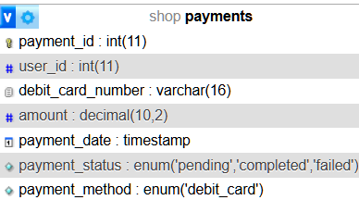
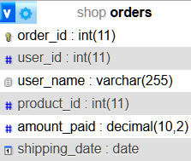
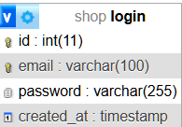
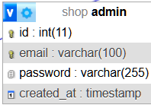
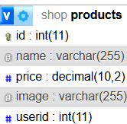
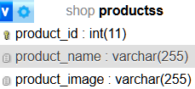
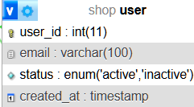
Figure: Schema Design

Slide 24
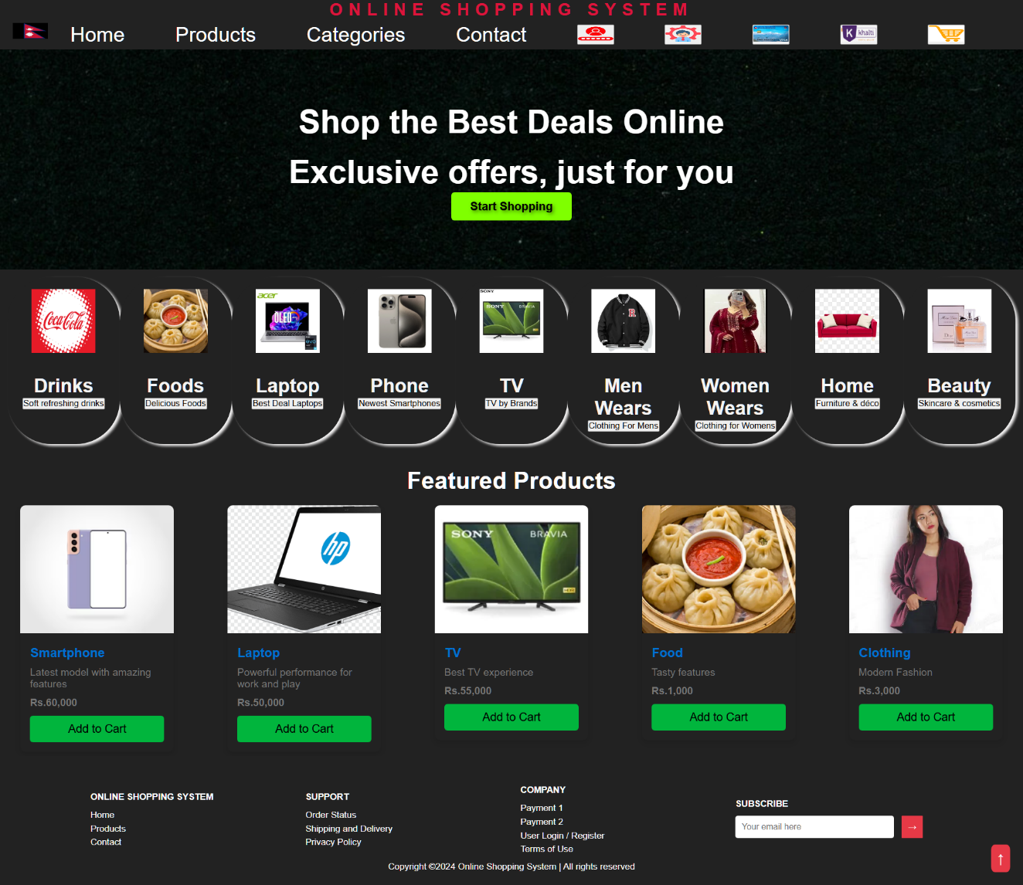
Interface Design
Figure: Front page

Slide 25
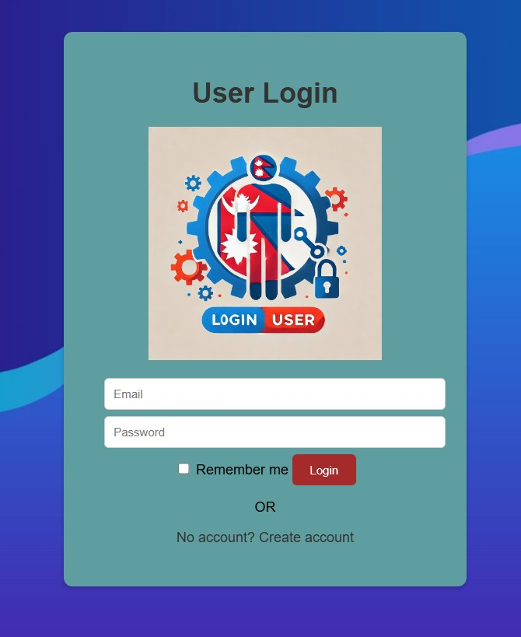
Figure: Login page

Slide 26
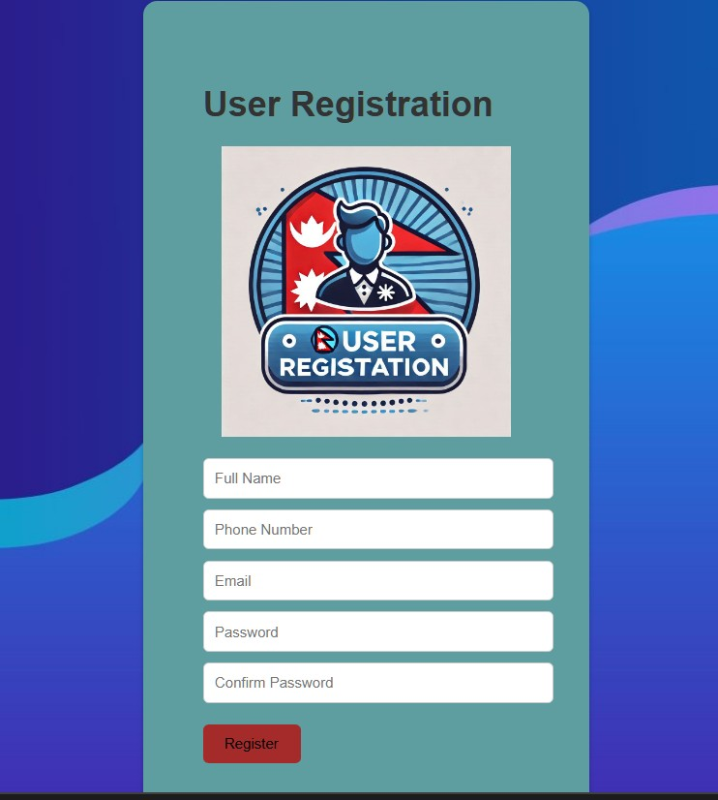
Figure: Register page

Slide 27
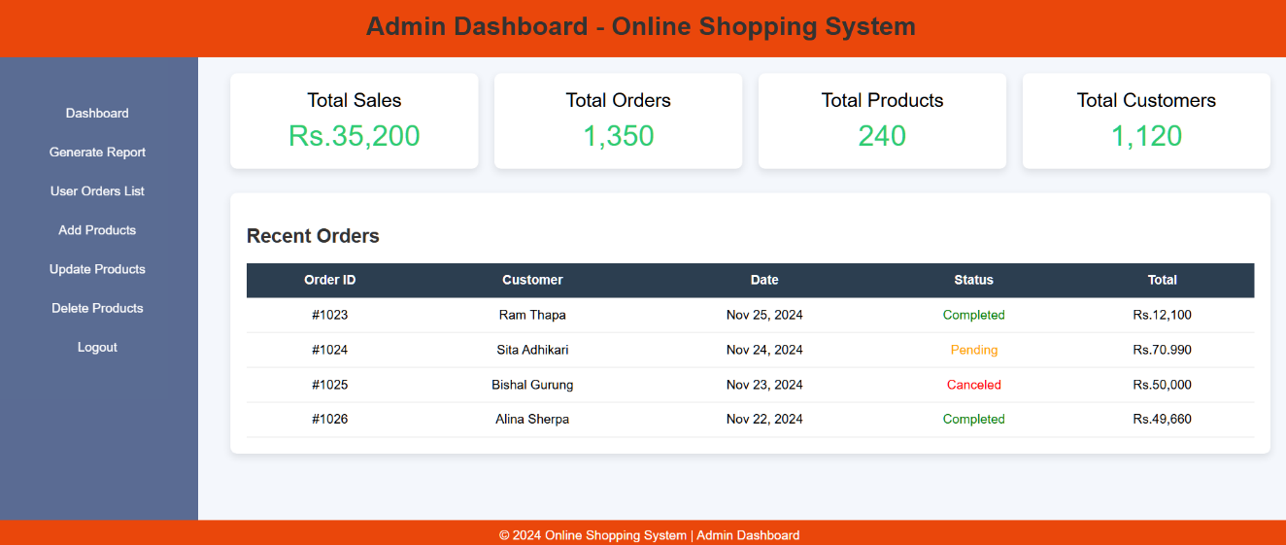
Figure: dashboard of Online Shopping System (Admin)

Slide 28
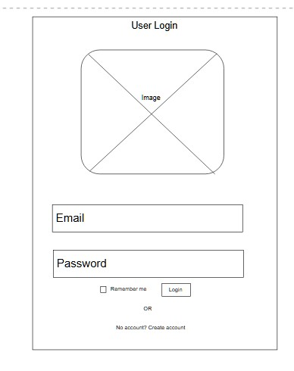
Figure: Wireframe of user’s login page

Slide 29
IMPLEMENTATION
Theoretical design is turned into a working system.
This is a crucial stage for creating a successful system.
It builds confidence for users that the system will work efficiently and effectively.
The system is implemented only after thorough testing.
Implementation happens if the system meets the specifications.

Slide 30
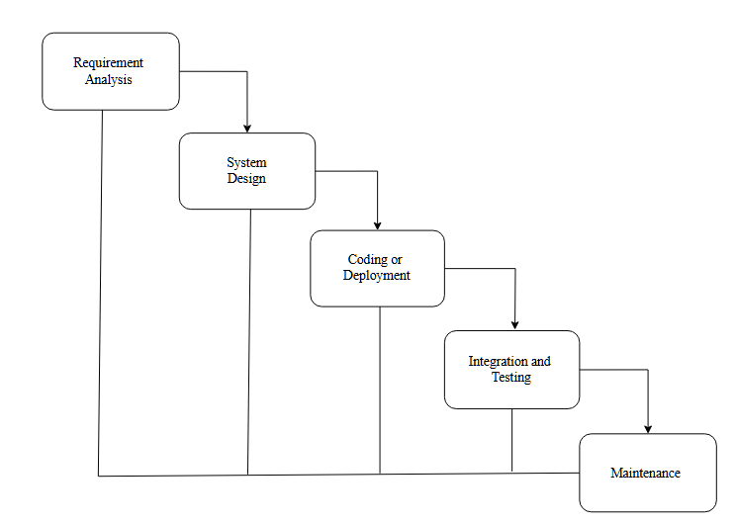
TOOLS USED:
1. Waterfall Model

Slide 31
2. HTML
3.CSS
4.JavaScript
5.PHP
6. MySQL
7. Apache

Slide 32
IMPLEMENTATION DETAILS OF MODULES
User Registration
User module
Admin module
Product module
Cart module
Payment module
Report module

Slide 33
Unit Testing
we would require:
The procedures belonging to other modules that the module under test calls.
Non local data structures that module accesses.
A procedure to call the functions of the module under test

Slide 34
Table 3: Test Case 1 of User Registration
Condition | Input | Steps | Output | Expected Result | Actual Result | Result
Should be Register | Full Name: Ram Nepal Phone Number: 9812332210 Email: ram44@gmail.com Password: Ram12@R# Confirm Password: Ram12@R# | Enter the Full Name, Phone Number, Email, Password, Confirm Password | All the steps Should be register into the system | All Steps are Registered | All Steps are Registered | Pass

Slide 35
Table 4: Test Case 2 of User Login
Condition | Input | Steps | Output | Expected Result | Actual Result | Result
Should be logged into the system | Email: ram44@gmail.com Password: Ram12@R# | Enter the valid Email, Password, login button | Email should be logged into the system | Navigate to the user dashboard page | Error | Fail

Slide 36
Table 5: Test Case 3 of Updated User Login
Condition | Input | Steps | Output | Expected Result | Actual Result | Result
Should be logged into the system | Email: ram44@gmail.com Password: Ram12@R# | Updated statement in header (Location path). | Email should be logged into the system | Navigate to the user dashboard page | Navigate to the user dashboard page | Pass

Slide 37
Table 6: System Testing of Online Shopping System
Test Description | Test Steps | Test Data | Expected Outcomes | Actual Outcomes | Remarks
User Registration | Enter all the valid information | Full Name: Ram Nepal Phone Number: 9812332210 Email: ram44@gmail.com Password: Ram12@R# Confirm Password: Ram12@R# | Successfully registered | Successfully registered | Pass
User login | Enter all registered information | Email: ram44@gmail.com Password: Ram12@R# | Navigate to the user dashboard | Navigate to the user dashboard | Pass
Add Products | Enter required product information | Product Name: Dell i3, Product Price: 10,000, Product Image: img2.jpeg | Added successfully | Added successfully | Pass
Update Products | Enter required product information | Product ID:1111, Product Name: Dell i3, Product Price: 11,000, Product Image: img2.jpeg | Updated successfully | Updated successfully | Pass
Delete Products | Enter required product information | Product ID:1111, Product Name: Dell i3, Product Price: 11,000, Product Image: img2.jpeg | Deleted successfully | Deleted successfully | Pass
Admin login | Enter admin login email and password | Email: cecepywo@mailinator.com Password: Pa$$w0rd! | Navigate to the admin dashboard | Navigate to the admin dashboard | Pass
Generate Report | Click to see report | View report | Admin views all report | Admin views all report | Pass

Slide 38
FUTURE RECOMMENDATIONS
Can be added proper payment gateway,
More Responsiveness website,
Can be added inventory management system,
Can be added multilingual to this site,
Payment Options Must Be Plentiful - Some customers pay with credit cards, debit cards, while others use E-sewa, Fone pay, Mobile Banking etc. Make sure the options are all there.
And many features can be added to this project to make it more robust

Slide 39
CONCLUSION
The project is flexible and user-friendly.
Most requirements have been fulfilled, remaining ones can be completed with a short extension.
Developed using HTML, CSS, JavaScript, PHP, and MySQL, making it executable on any system.
The website was tested with maximum load and works fast and effectively.
The online shopping system offers a wide range of products like electronics, clothing, home decoration, and food.
Users can search for and purchase products easily.
Users can log in to view order status, request items, and provide suggestions.
Admin login allows adding, updating, or deleting products, reviewing user activity, checking order list, and generating reports.

Slide 40
Thank you
Any Query

